Slide 1
Assignment Summary
Pratima Rathore

Slide 2
Problem Statement
HELP International is an international humanitarian NGO that is committed to fighting poverty and providing the people of backward countries with basic amenities and relief during the time of disasters and natural calamities. It runs a lot of operational projects from time to time along with advocacy drives to raise awareness as well as for funding purposes.
Business Goal
Our job is to categorize the countries using some socio-economic and health factors that determine the overall development of the country. Then you need to suggest the countries which needs to focused on the most.
Data Understanding
This assignment has 2 files as explained below:
‘country_data.csv' contains all the socio-economic factors for various countries.
‘country_dictionary.csv' is data dictionary which describes the meaning of the features.

Slide 3
STEPS FOLLOWED IN THE ASSIGNMENT
Step 1: Reading and Understanding the Data
Step 2: Data Cleansing
Missing Value check
Data type check
Step 3: Data Visualization
Univariant & Bivariant Analysis
Heatmap
Pairplot
Step 4: Data Preparation
Rescaling
Step 5: Hopkins Statistics Test
Step 6: Model Building
K-means Clustering
Elbow Curve
Silhouette Analysis
Hierarchial Clustering
Step 7: Final Analysis
Final Country list Preparation

Slide 4
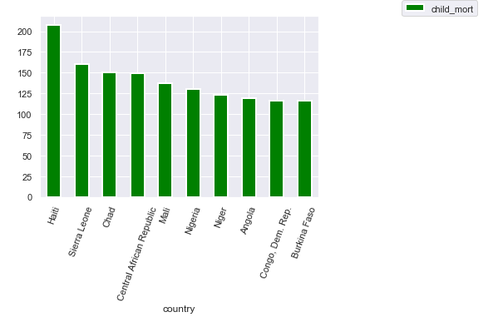
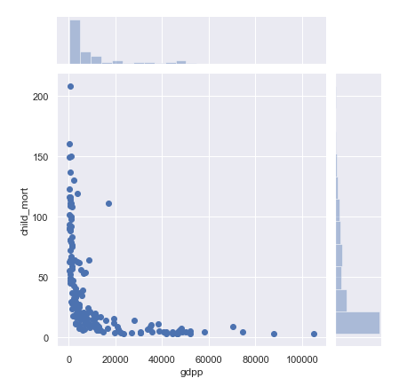
Various socio-economic factors
Countries with highest child mortality
Relationship between gdpp vs child mortality of a country
As we can see , if gdpp increases for a country child mortality decreases , so we should be focusing on countries with less gdpp.

Slide 5
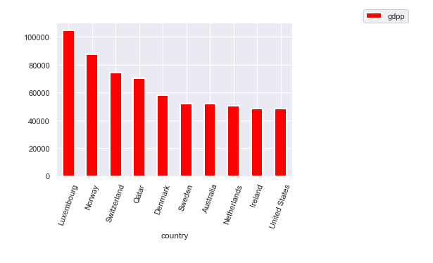
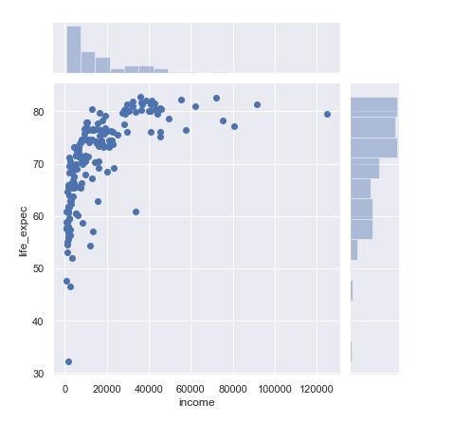
Various socio-economic factors
Countries with highest gdpp
Relationship between income vs life expectancy of a country
As we can see , if income increases life expectancy also increase , so we should be focusing on countries with less income.

Slide 6
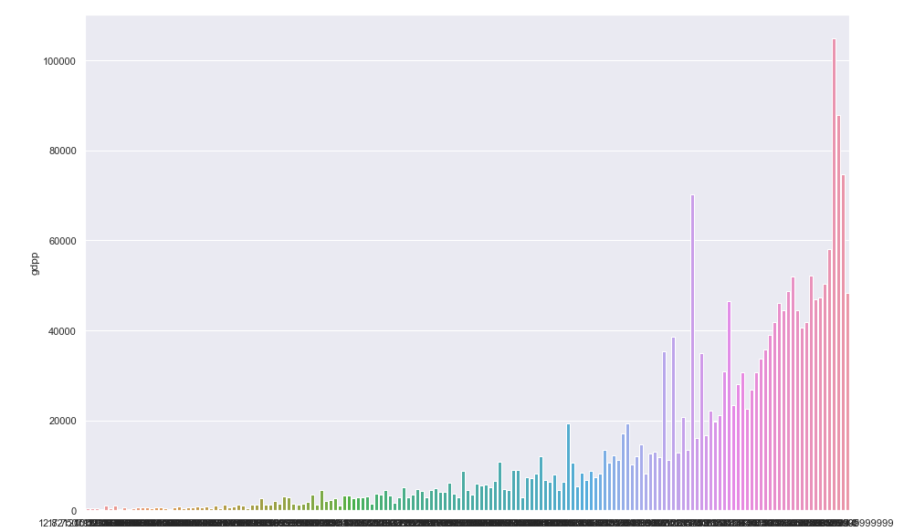
Various socio-economic factors
Relationship btw gdpp and health across various countries
We can say as the gdpp increases for a country , health situation also improves .

Slide 7
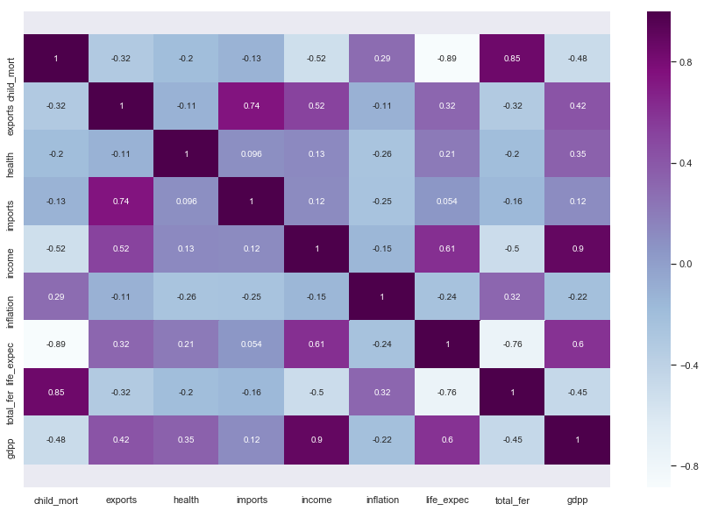
Heatmap showing relationship btw various features

Slide 8
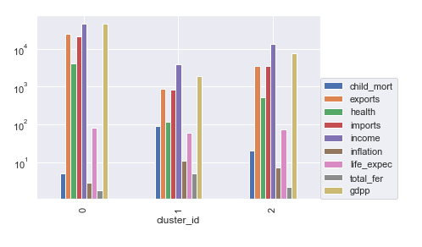
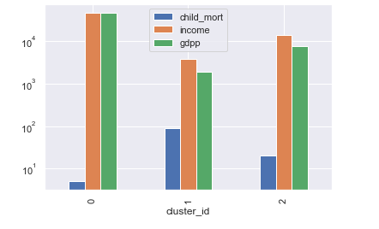
Cluster defining features for the dataset ( k-mean algorithm)
We can see , child mortality , income and gdpp are the factors that have great influence on cluster formation

Slide 9
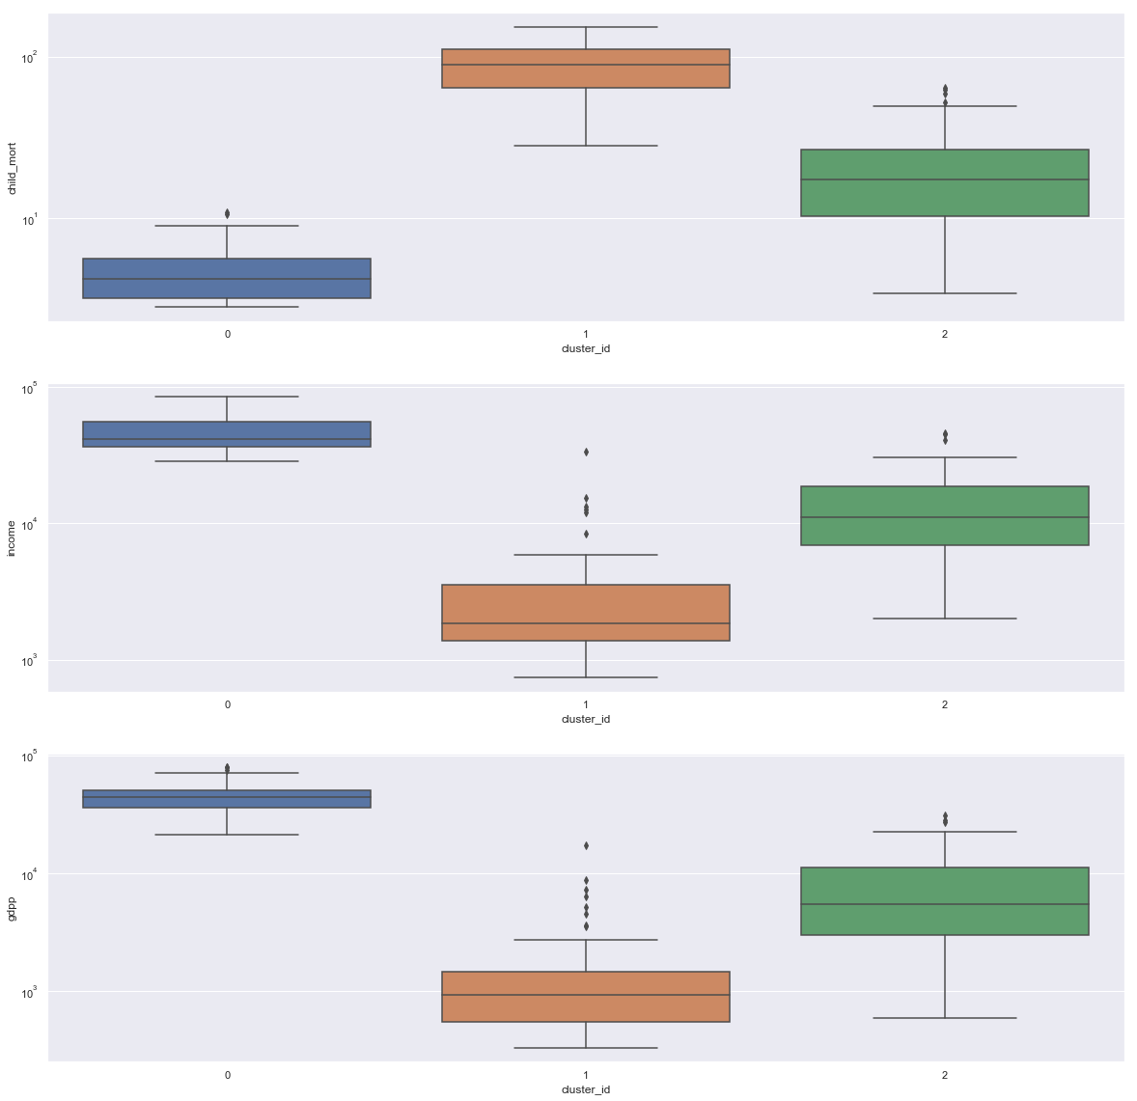
Cluster defining features for the dataset
( k-mean algorithm)
As we can see,
we have 3 clusters 0 , 1 and 2.
And as we are interested in countries which are poor in socio-economic conditions ie poor income and gdpp and high child mortality.
Here we can see, cluster 1 has high mortality and low gdpp and income , so that is the desired cluster we are looking for .
CLUSTER-1

Slide 10
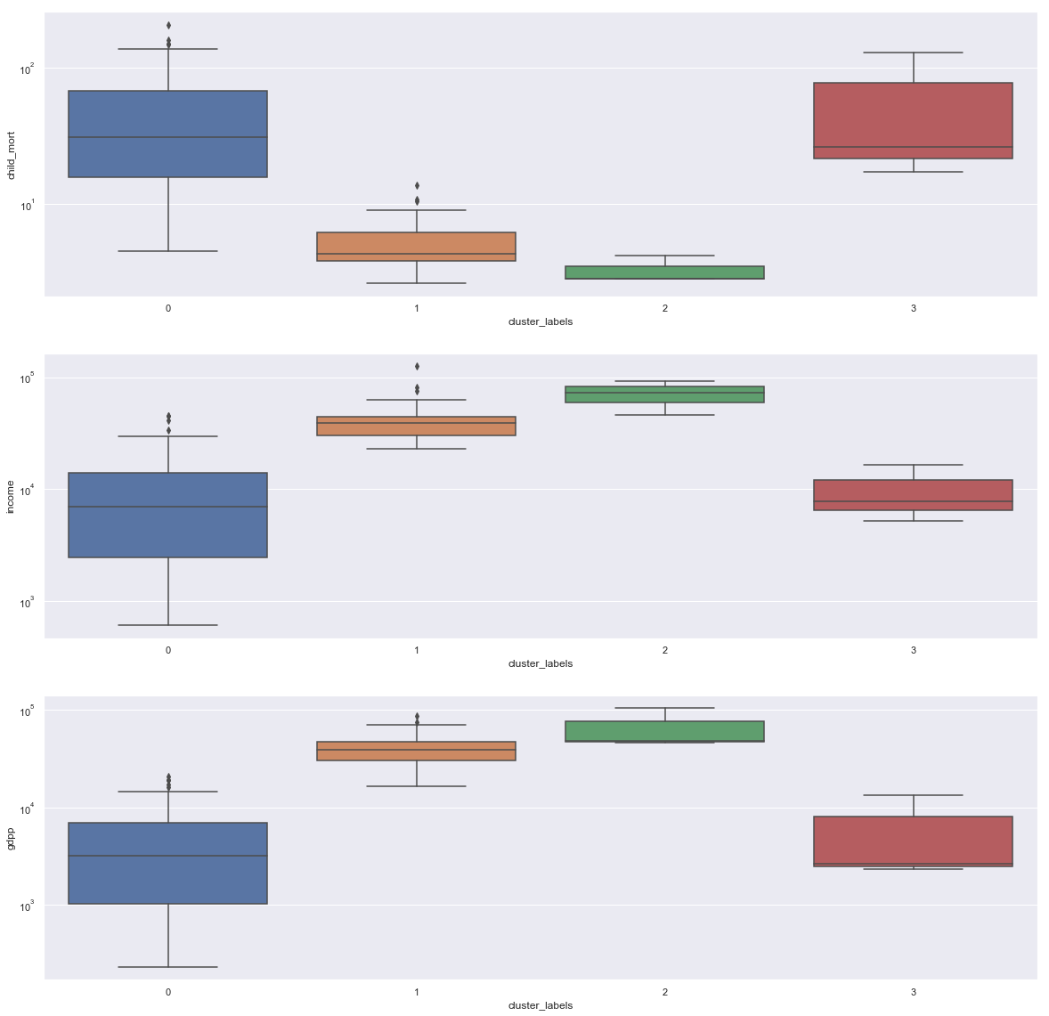
Cluster defining features for the dataset
( hierarchical algorithm)
As we can see,
we have 4 clusters 0 , 1 ,2 and 3.
And as we are interested in countries which are poor in socio-economic conditions ie poor income and gdpp and high child mortality.
Here we can see, cluster 0 and 3 has high mortality and low gdpp and income , so that is the desired cluster we are looking for . But btw the two , cluster 0 has mre aggreviated result.
CLUSTER-0

Slide 11
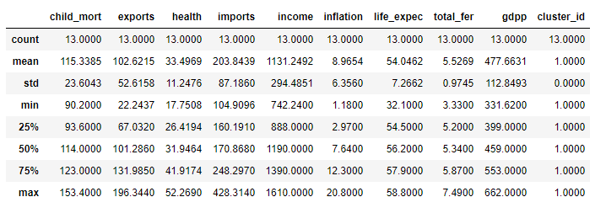
Countries in order of low gdpp , low income and high child mortality
We got very similar result with k-mean and hierarchical clustering, but moving forward with k-mean as the cluster distribution seems better distributed ie [29,48,90] and [128,33,3,3] respectively .
Leaving us with 48 countries in target cluster in k-mean and 128 countries in target cluster for hierarchical.
As we can see there are countries with low child mortality but low gdpp and income . Similary high mortality and high gdpp and income. We have to look for countries that strike have bad condition in terms of money ( low income/gdpp) and health (high child mortality)
Then we processed it further by keeping the countries with more than the mean child mortality , less then the mean gdpp and income .
Gradually leaving us a dataset with 13 countries .

Slide 12
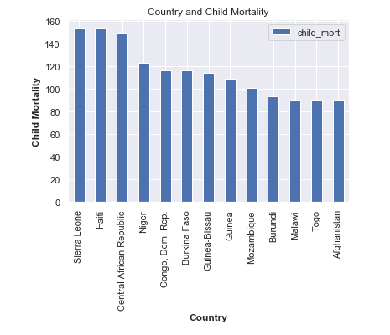
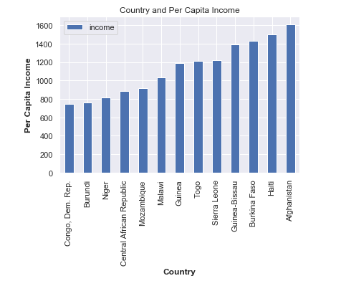
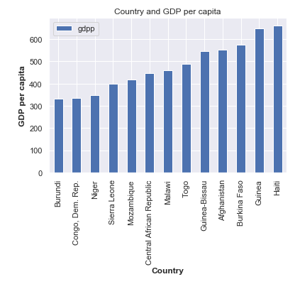
Final List of countries which are in need of the aid based on socio-economic factors
Looking for the best combination of high child mortality , low income and low gdpp, here is the list of top 5 countries that are very much in need for the aid by the NGO –
Sierra Leone
Burundi
Central African Republic
Niger
Congo, Dem. Rep.

